Slide 1

Task Organizer App - MET
Simplify your daily workflow with our intuitive Task Organizer App. Designed for developers and designers, this application helps you manage tasks efficiently, ensuring you never miss a deadline or lose track of important documents.

Slide 2




Core Technologies
Flet UI Framework
CSV for Data Storage
Leveraging Flet for a modern, cross-platform user interface. This Pythonic approach enables rapid development and a native look and feel
Simple, robust data persistence using standard CSV files, ensuring offline accessibility and easy sharing.
Datetime for Deadlines
Flet Navigator
Efficiently manage task deadlines with Python's built-in datetime module, ensuring timely completion.
Seamless multi-page navigation is handled by flet_navigator, providing a smooth user experience.

Slide 3
Object-Oriented Design
Our application's architecture is built on a clear Object-Oriented Programming (OOP) paradigm, ensuring modularity, scalability, and ease of maintenance.
TaskOrganizer Class
The central hub for managing application state, UI interactions, and data persistence. It orchestrates the overall task management experience.
Manages all task operations
Handles CSV import/export
Orchestrates UI updates
Task Class
Represents an individual task, encapsulating its data and specific logic for editing or deletion. This separation ensures clear responsibilities.
Manages individual task data
Handles task-specific actions (edit/delete)
Ensures data integrity per task

Slide 4



TaskOrganizer: The Core Logic
The TaskOrganizer class is the backbone of the application, handling all critical task management functions and UI interactions.
Adding Tasks
CSV Persistence
CRUD Operations
The add_clicked method processes new task entries, validates input, and integrates them into the main task list.
csv_save_clicked and csv_open_clicked manage the secure saving and loading of task data to and from CSV files.
task_delete and task_edit methods enable full Create, Read, Update, Delete (CRUD) functionality for individual tasks.
The class also orchestrates the integration of various UI elements like input fields, action buttons, and a date picker for intuitive user interaction.

Slide 5
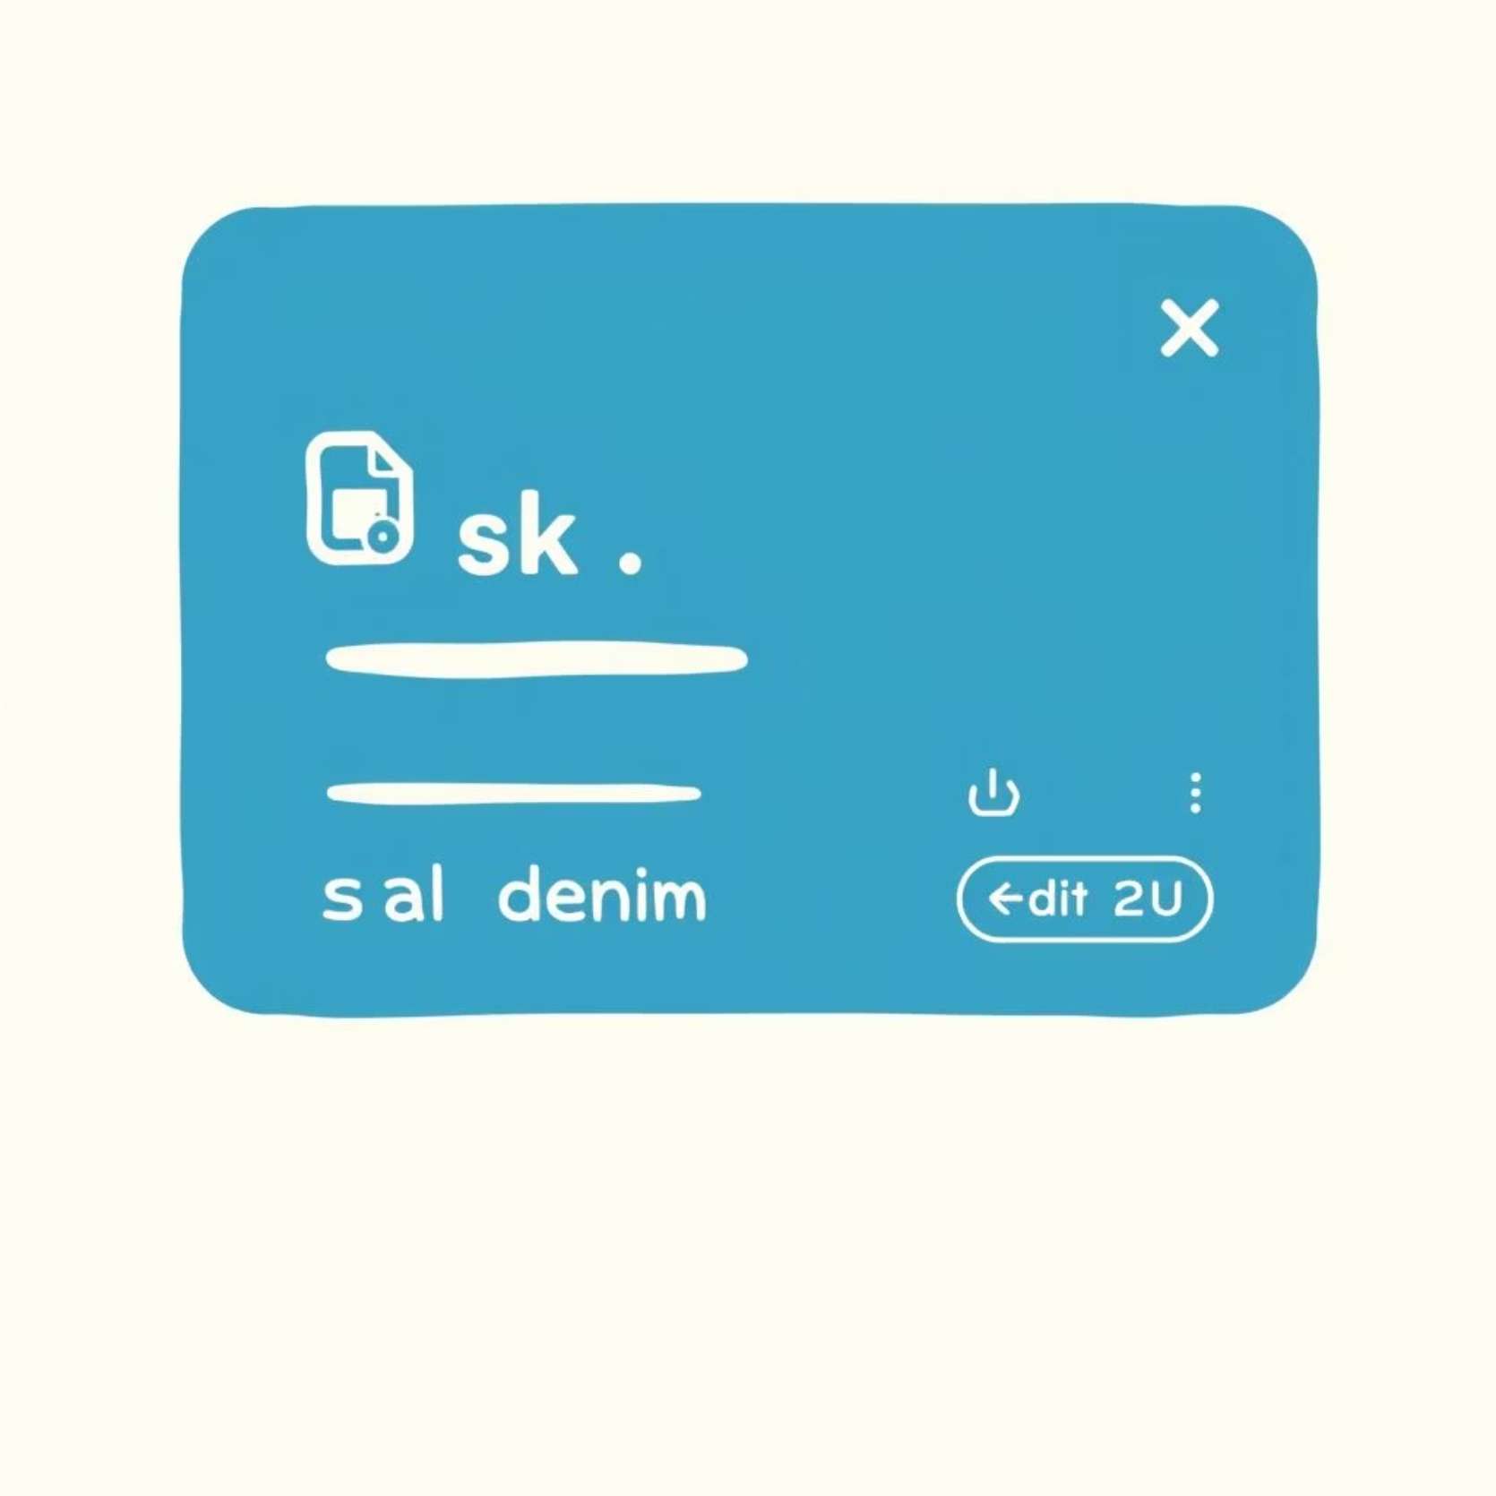
Task Class: Individual Task Representation
The Task class encapsulates the details and behaviors of each individual task within the application. It ensures that each task can be managed independently and efficiently.
Task Name: A concise description of the task.
Document Link: An optional URL or path to related documents.
Date Today: The deadline for the task, handled by the date picker.
Edit Mode Toggle
1
The edit_clicked method switches the task's display between read-only and editable states.
Save Changes
2
The save_clicked method persists any modifications made to the task, updating its attributes and reflecting changes in the UI.

Slide 6




Intuitive User Interface
The app's UI is designed for clarity and ease of use, making task management simple and efficient.
Task & Link Inputs
Action Buttons
Scrollable Task List
Dedicated input fields for task names and associated document links, streamlining information entry.
Clearly labeled buttons for adding, editing, deleting, and managing CSV operations provide immediate control.
A dynamic, scrollable list displays all tasks with their respective deadlines, ensuring easy overview and navigation.

Slide 7
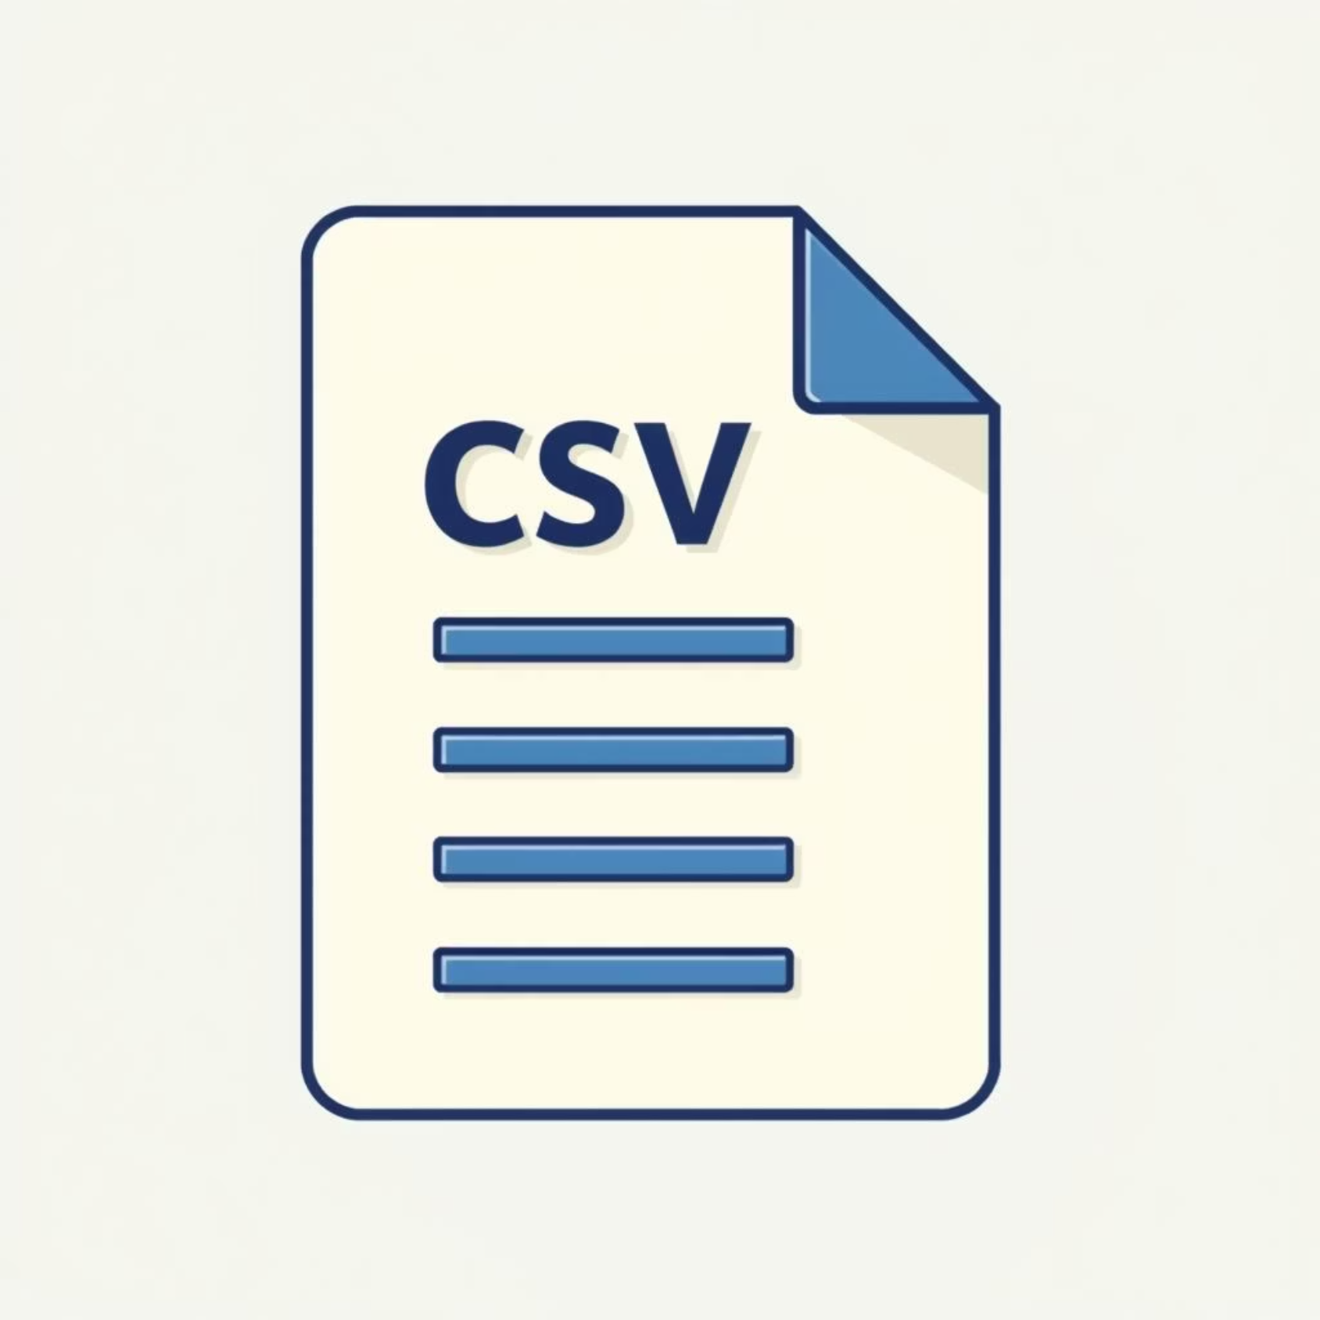



Data Persistence with CSV
The Task Organizer App uses CSV files for robust and portable data storage, enabling offline access and easy data manipulation.
Standard Format
Tasks are stored in a consistent CSV format: [Task, Document Link, Deadline].
Saving Data
The csv_save_clicked method ensures all current tasks are securely written to the specified CSV file.
Loading Data
The csv_open_clicked method efficiently reads existing tasks from a CSV file, populating the app.

Slide 8

Seamless Navigation Flow
The app utilizes flet_navigator to provide a smooth, intuitive multi-page routing experience.
01
02
03
Home Screen (/)
Lobby (/lobby)
Return to Home
The initial welcome screen, guiding users with a clear "START" button to begin their task management journey.
The primary interface where users interact with their tasks: adding, editing, deleting, and managing deadlines.
A dedicated "Back" button ensures users can easily navigate back to the welcome screen at any time.

Slide 9



Why Choose This App?
Our Task Organizer App offers unique advantages that make it an essential tool for efficient task management.
Offline-First Access
Simple & Effective UI
Highly Extensible
Ensures your task data is always available via CSV storage, even without an internet connection.
A minimalist design paired with integrated date pickers for intuitive deadline management.
Designed with modularity in mind, allowing for future enhancements like task priorities or categories.

Slide 10

Live Demo & Q&A
Let's see the Task Organizer App in action and open the floor for your questions.
Demo Walkthrough:
Questions & Discussion
Adding a Task: We'll demonstrate how to quickly input a new task with a deadline.
We're eager to hear your thoughts and answer any questions you might have about the Task Organizer App.
Editing & Deleting: Showcasing the seamless process of modifying and removing tasks.
CSV Operations: Illustrating how to save and load your tasks from a CSV file for portability.
Let's discuss its potential and future enhancements!

